Slide 1
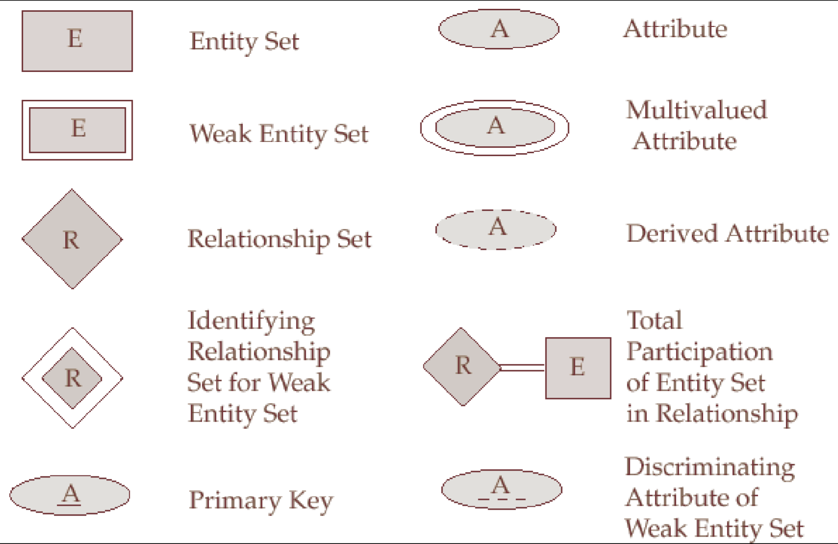


Slide 2
Entity and Attribute
Entity
  An object with a physical existence or conceptual existence
  e.g. a person, a company
  Notation
Attributes
  Properties that describe entities
  e.g. Name of an employee
  Notation

Slide 3
Attribute
- Simple vs. Composite attribute
Simple (atomic) attribute
  Attribute that are not divisible
  e.g. SSN, ZIP code
  Notation
Composite Attribute
  can be divided into smaller subparts
  e.g. Address
  Notation

Slide 4
Attribute
- Single value vs. Multivaled attribute
Single-valued attribute
  e.g. Age of a person
Multivalued attribute
  e.g. College degree
  Notation

Slide 5
Attribute
- Stored vs. Derived attribute
Stored attribute
  e.g. birthDate
Derived attribute
  Derived from other attribute
  e.g. age = current date – birthDate
  Notation

Slide 6
Entity types and entity sets
Entity Type
  Defines a collection of entities that have the same attributes.
  e.g. employee
  describe the schema or intension for a set of entities that share the same structure.
Entity Set
  The collection of all entities of a particular entity type in the database at any point in time is called an entity set.
  e.g. a set of instances of employees.
  Also called the extension of the entity type.

Slide 7
ER Diagram For Entity and Attribute
Entity
Single Attribute
Composite Attribute
Multi-valued Attribute
Derived Attribute

Slide 8
Key
A key is an attribute or the combination of multiple attributes that can be used to distinguish one entity instance from other entity instances in an entity type.
  (e.g. SSN of an employee)
Composite Key: A set of attributes as the key of an entity.
Key must be minimal
Notations
Composite attributes as a key

Slide 9
Value Sets
Value set (or domain of values):
The set of values that may be assigned to the attribute for each individual entity
e.g. age of employee:
value set: integer between 16 and 70
Not displayed in ER diagram

Slide 10
Relationship
Relationship Type
  Defines a set of associations among entity types
  e.g. Employees work for a department.
Relationship Instance
  Instance of a relationship type that associates with entity instances.
Employee
Works_For
Department

Slide 11
Example of Relationship Instance
e1
r1
d1
e2
r2
d2
e3
r3

Slide 12
Structure Constraint
Cardinality Ratios
Participation or Optionality Constraints

Slide 13
Cardinality Ratios for Binary Relationship
Specify the the number of relationship instances that an entity can participate in.
Possible cardinality ratios
  1:1 (one to one)
  1:N (one to many)
  N:1 (many to one)
  M:N (many to many)

Slide 14
Cardinality Ratio 1:1
One instance of A can be associated with only one instance of B. One instance of B can be associated with only one instance of A.
A
1
1
B

Slide 15
Cardinality Ratio 1:N
One instance of A can be associated with any number of instances of B
One instance of B can be associate with only one instance of A
A
1
N
B

Slide 16
Cardinality Ratio M:N
One instance of A can be associated with any number of instances of B
One instance of B can be associate with any number of instances of A
A
M
N
B

Slide 17
Participation Constraints
Total Participation (Existence dependency)
  Any employee must work for one department.
Partial Participation
  Some of the employee entities manage department entities, but not necessary all.
Employee
Employee
1
N
Manages
Works_For
1
1
Department
Department

Slide 18
Relationship role name
Each entity type that participates in a relationship type plays a particular role.
Role name: signify the rule that a participating entity from the entity type plays in each relationship instance.
e.g. employee plays the role of worker
department plays the role of employer.

Slide 19
Recursive Relationship
The Same entity type participates more than once in a relationship type in different roles.
Employee
supervisor
supervisee
1
N
Supervisions

Slide 20
Weak Entity
Figure
Does not have key attributes of its own.
Has total participation constraints
Partial Key: Unique identifier of a weak entity that can be used to distinguished from other weak entities related to the same owner entity

Slide 21
Non-Binary Relationship
PartNo
Part
SName
M
ProjName
Supplier
Supply
Project
N
K
Quantity
A ternary relationship

